Slide 1
Module Seven: Hot topics in Service Computing - Cloud -

Slide 2
Topic 6: Problems with cloud computing

Slide 3
Security Issues in Cloud Computing

Slide 4
Intended learning outcomes
After completing this topic, you will be able to:
Present cloud issues/characteristics that create interesting security problems
Identify a few security issues within this framework
Discuss some approaches that address these issues

Slide 5
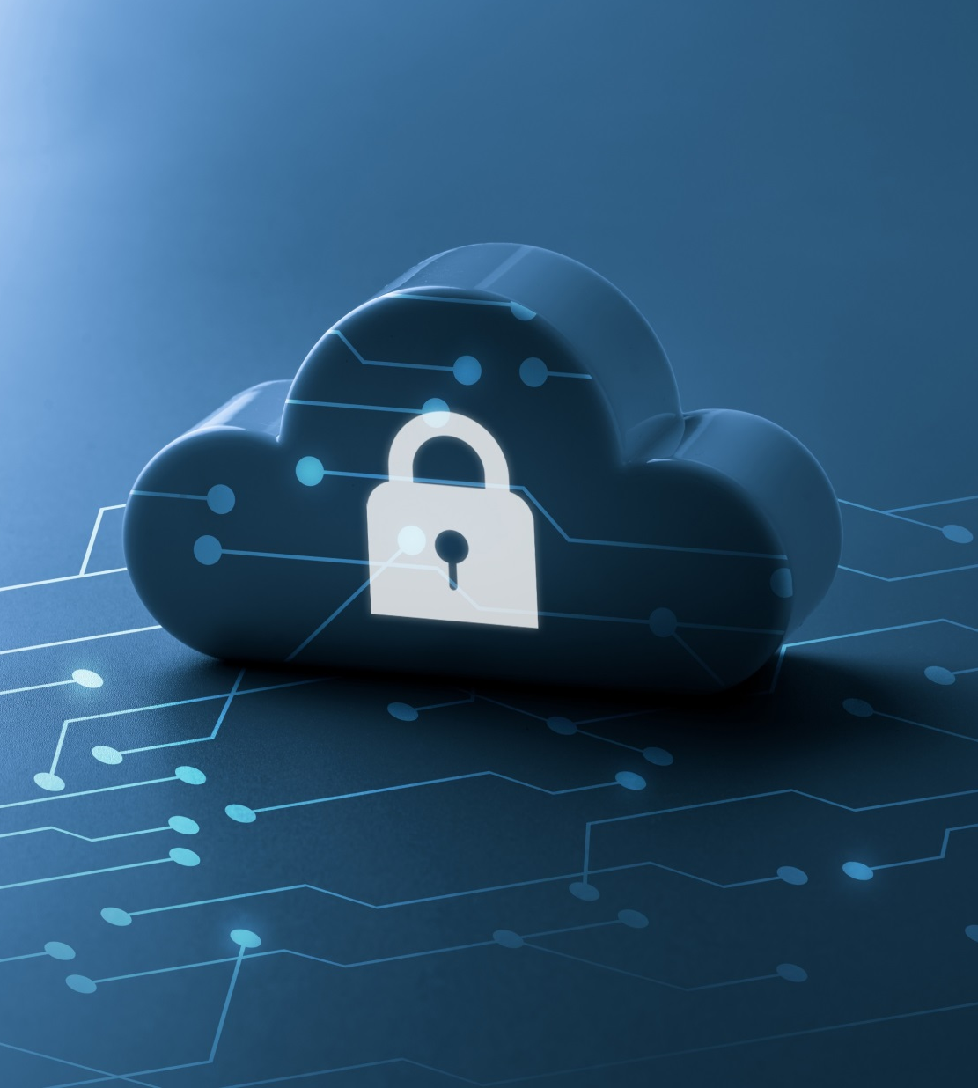
Some Cloud Security Statistics
Security and risk management spending grew 6.4% in 2020
As per a recent study, 79% of enterprises want better integrated security and governance for their data in the cloud

Slide 6
Cloud Computing: A Massive Concentration of Resources
Also a massive concentration of risk
expected loss from a single breach can be significantly larger
concentration of “users” represents a concentration of threats
“Ultimately, you can outsource responsibility but you can’t outsource accountability.”
J. McDermott, (2009) "Security Requirements for Virtualization in Cloud Computing," presented at the ACSAC Cloud Security Workshop, Honolulu, Hawaii, USA, 2009.

Slide 7
Threats & Vulnerabilities
Threat is harm or unauthorized access that might occur due to vulnerability and destroy organization assets, organization operations or system information
Vulnerability is any weakness in information system, system security procedures, internal controls or implementation that could be exploited or triggered by a threat resources

Slide 8
Threats
Data loss or leakage
Denial of service attack
Malicious insider
Data breaches
Abuse of cloud services
Unauthorized access to API
…

Slide 9
Vulnerabilities
Insufficient due diligence
Misconfigured cloud services
Insecure interface
Obsolete cryptography
Insecure VM migration
Internet protocol
Vendor lock-in
…

Slide 10
Real life examples (1)
Malware infections
Malicious software
Cloud Snooper – cloud malware that infected cloud infrastructure servers hosted in the AWS cloud, using sophisticated techniques to evade detection and communicate with its servers through a firewall

Slide 11
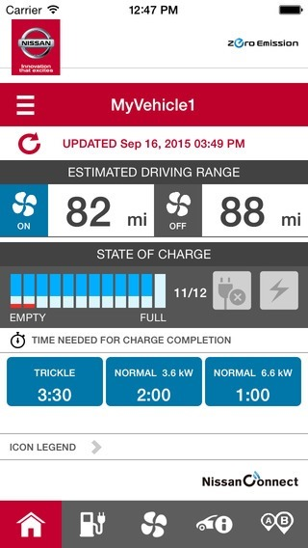
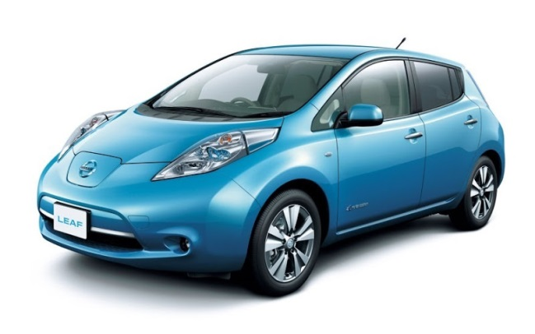
Real life examples (2)
Unauthorized access to API
When developers create APIs with inadequate authentication, they can contain security vulnerabilities that allow anyone to access your corporate data.
Example - Nissan — an API flaw resulted in the ability for hackers to remotely control some features of the Nissan LEAF.

Slide 12
Real life examples (3)
Misconfigured cloud services
A cloud misconfiguration happens when a user or admin fails to properly set a cloud platform’s security setting.
The Alteryx breach in 2017, during which the online marketing firm exposed data from millions of households by misconfiguring an AWS S3 Bucket.

Slide 13
Cloud Computing: who should use it?
Cloud computing definitely makes sense if your own security is weak, missing features, or below average
Ultimately, if
the cloud provider’s security people are “better” than yours (and leveraged at least as efficiently),
the web-services interfaces don’t introduce too many new vulnerabilities, and
the cloud provider aims at least as high as you do, at security goals,
then cloud computing has better security
J. McDermott, (2009) "Security Requirements for Virtualization in Cloud Computing," presented at the ACSAC Cloud Security Workshop, Honolulu, Hawaii, USA, 2009.

Slide 14
Problems Associated with Cloud Computing
Most security problems stem from:
Loss of control
Lack of trust (mechanisms)
Multi-tenancy
These problems exist mainly in 3rd party management models
Self-managed clouds still have security issues, but not related to above
Notes:
14
Data mobility: the abiltiy to share data between cloud services
Where does data reside?
- out-of-state, out-of-country issues
Security Concerns for government in particular
FISMA
How to certify and accredit cloud computing providers under FISMA
(e.g. ISO 27001)

Slide 15
Loss of Control in the Cloud
Consumer’s loss of control
Data, applications, resources are located with provider
User identity management is handled by the cloud
User access control rules, security policies and enforcement are managed by the cloud provider
Consumer relies on provider to ensure
Data security and privacy
Resource availability
Monitoring and repairing of services/resources

Slide 16
Lack of Trust in the Cloud
Need for trust arises only in risky situations
Defunct third party management schemes
Hard to balance trust and risk
Notes:
Chiles and McMakin (1996) define trust as increasing one’s vulnerability to the risk of opportunistic behavior of another whose behavior is not under one’s control in a situation in which the costs of violating the trust are greater than the benefits of upholding the trust.
Trust here means mostly lack of accountability and verifiability

Slide 17
Multi-tenancy Issues in the Cloud
Conflict between tenants’ opposing goals
Tenants share a pool of resources and have opposing goals
How to provide separation between tenants?
Notes:
Who are my neighbors? What is their objective? They present another facet of risk and trust requirements

Slide 18
Security Issues in the Cloud
In theory, minimizing any of the issues would help:
Loss of Control
Take back control
Data and apps may still need to be on the cloud
But can they be managed in some way by the consumer?
Lack of trust
Increase trust (mechanisms)
Technology
Policy, regulation → this topic has been studied when we talked about cloud standardization and regulation in China and internationally
Multi-tenancy
Private cloud
Takes away the reasons to use a cloud in the first place
VPC: its still not a separate system
Strong separation
Notes:
While VPC providers argue that they provide superior isolation, the fact of the matter is that your data is not a separate physical system: your data is still stored on actual servers along with other consumers’ data, but logically separated. If the actual server fails, your data and applications stored on it are lost. Also, there needs to be a high level of trust as to the degree of isolation provided.

Slide 19
Minimize Lack of Trust: Policy Language
Create policy language with the following characteristics:
Machine-understandable (or at least processable),
Easy to combine/merge and compare
Examples of policy statements
“requires isolation between VMs”
“requires geographical isolation between VMs”
“requires physical separation between other communities/tenants that are in the same industry,”
Need a validation tool to check that the policy created in the standard language correctly reflects the policy creator’s intentions (i.e. that the policy language is semantically equivalent to the user’s intentions)
Notes:
These SLAs typically state the high level policies of the provider (e.g. Will maintain uptime of 98%) and do not allow cloud consumers to dictate their requirements to the provider. COI clouds in particular have specific security policy requirements that must be met by the provider, due to the nature of COIs and the missions they are used for. These requirements need to be communicated to the provider and the provider needs to provide some way of stating that the requirements can be met. Cloud consumers and providers need a standard way of representing their security requirements and capabilities. Consumers also need a way to verify that the provided infrastructure and its purported security mechanisms meet the requirements stated in the consumer’s policy (proof of assertions). For example, if the consumer’s policy requires isolation of VMs, the provider can create an assertion statement that says it uses cache separation to support VM isolation.

Slide 20
Minimize Lack of Trust: Certification
Certification
Some form of reputable, independent, comparable assessment and description of security features and assurance
Risk assessment
Performed by certified third parties
Provides consumers with additional assurance

Slide 21
Minimize Loss of Control in the Cloud
Monitoring
Utilizing different clouds
Access control management

Slide 22
Minimize Loss of Control: Monitoring (1)
Cloud consumer needs situational awareness for critical applications
When underlying components fail, what is the effect of the failure to the mission logic
What recovery measures can be taken (by provider and consumer)
Notes:
When the underlying components fail in the cloud, the effect of the failures to the mission logic needs to be known so that correct recovery measures can be performed. We propose an application-specific run-time monitoring and management tool. With this tool, the application logic can remain on the consumer’s host computer. This allows the consumer to centrally monitor all aspects of the application as well as data flow. Since all outputs from underlying services are sent to the application logic, any data incompatibility between services is not an issue. The capabilities of the run-time monitoring and management tool are as follows: 1) Enable application user to determine the status of the cloud resources that may be used to run the application (across multiple clouds), 2) Enable application user to determine the real-time security posture and situational awareness of the application, 3) Provide the application user with the ability to move user’s application (or part of it) to another site (other VM in same cloud or different cloud altogether), 4) Provide the application user with the ability to change the application logic on the fly, 5) Provide communicate capabilities with cloud providers. There are a few cloud vendors such as NimSoft [41] and Hyperic [42] that provide application-specific monitoring tools that provide some of the above functionality. These monitoring tools may be further enhanced or used in conjunction with other tools to provide the degree of monitoring required. However, any tool that is to be used for military purposes must also receive some type of accreditation and certification procedure.

Slide 23
Minimize Loss of Control: Monitoring (2)
Requires an application-specific run-time monitoring and management tool for the consumer
The cloud consumer and cloud provider have different views of the system
Enable both the provider and tenants to monitor the components in the cloud that are under their control
Provide mechanisms that enable the provider to act on attacks he can handle
Provide mechanisms that enable the consumer to act on attacks that he can handle (application-level monitoring)
Notes:
When the underlying components fail in the cloud, the effect of the failures to the mission logic needs to be known so that correct recovery measures can be performed. We propose an application-specific run-time monitoring and management tool. With this tool, the application logic can remain on the consumer’s host computer. This allows the consumer to centrally monitor all aspects of the application as well as data flow. Since all outputs from underlying services are sent to the application logic, any data incompatibility between services is not an issue. The capabilities of the run-time monitoring and management tool are as follows: 1) Enable application user to determine the status of the cloud resources that may be used to run the application (across multiple clouds), 2) Enable application user to determine the real-time security posture and situational awareness of the application, 3) Provide the application user with the ability to move user’s application (or part of it) to another site (other VM in same cloud or different cloud altogether), 4) Provide the application user with the ability to change the application logic on the fly, 5) Provide communicate capabilities with cloud providers. There are a few cloud vendors such as NimSoft [41] and Hyperic [42] that provide application-specific monitoring tools that provide some of the above functionality. These monitoring tools may be further enhanced or used in conjunction with other tools to provide the degree of monitoring required. However, any tool that is to be used for military purposes must also receive some type of accreditation and certification procedure.

Slide 24
Minimize Loss of Control: Utilize Different Clouds
The concept of ‘Don’t put all your eggs in one basket’
Consumer may use services from different clouds through an intra-cloud or multi-cloud architecture
A multi-cloud or intra-cloud architecture in which consumers
Spread the risk
Increase redundancy (per-task or per-application)
Increase chance of mission completion for critical applications
Notes:
Differering data semantics example: does a data item labeld secret in one cloud have the same semantics as another piece of data also labeled secret in a different cliud?

Slide 25
Minimize Loss of Control: Utilize Different Clouds
Possible issues to consider:
Policy incompatibility (combined, what is the overarching policy?)
Data dependency between clouds
Differing data semantics across clouds
Knowing when to utilize the redundancy feature (monitoring technology)
Is it worth it to spread your sensitive data across multiple clouds?
Redundancy could increase risk of exposure
Notes:
Differering data semantics example: does a data item labeld secret in one cloud have the same semantics as another piece of data also labeled secret in a different cliud?

Slide 26
Minimize Loss of Control: Access Control (1)
Many possible layers of access control
E.g. access to the cloud, access to servers, access to services, access to databases (direct and queries via web services), access to VMs, and access to objects within a VM
Depending on the deployment model used, some of these will be controlled by the provider and others by the consumer
Notes:
In cloud computing (as well as other systems), there are many possible layers of access control. For example, access to the cloud, access to servers, access to services, access to databases (direct and queries via web services), access to VMs, and access to objects within a VM. Depending on the deployment model used, some of these will be controlled by the provider and others by the consumer.
For example, Google Apps, a representative SaaS Cloud controls authentication and access to its applications, but users themselves can control access to their documents through the provided interface to the access control mechanism. In IaaS type approaches, the user can create accounts on its virtual machines and create access control lists for these users for services located on the VM.
Regardless of the deployment model, the provider needs to manage the user authentication and access control procedures (to the cloud). While some providers allow federated authentication – enabling the consumer-side to manage its users, the access control management burden still lies with the provider. This requires the user to place a large amount of trust on the provider in terms of security, management, and maintenance of access control policies. This can be burdensome when numerous users from different organizations with different access control policies, are involved. This proposal focuses on access control to the cloud. However, the concepts here could be applied to access control at any level, if deemed necessary. We propose a way for the consumer to manage the access control decision-making process to retain some control, requiring less trust of the provider.
Approach:
This approach requires the client and provider to have a pre-existing trust relationship, as well as a pre-negotiated standard way of describing resources, users, and access decisions between the cloud provider and consumer. It also needs to be able to guarantee that the provider will uphold the consumer-side’s access decisions. Furthermore, we need to show that this approach is at least as secure as the traditional access control model.
This approach requires the data owner to be involved in all requests. Therefore, frequent access scenarios should not use this method if traffic is a concern. However, many secure data outsourcing schemes require the user to grant keys/certificates to the query side, so that every time the user queries a database, the owner needs to be involved. Therefore, not much different than that so may not be a problem.

Slide 27
Minimize Loss of Control: Access Control (2)
Regardless of deployment model, provider needs to manage the user authentication and access control procedures (to the cloud)
Federated Identity Management: access control management burden still lies with the provider
Requires user to place a large amount of trust on the provider in terms of security, management, and maintenance of access control policies. This can be burdensome when numerous users from different organizations with different access control policies, are involved
Notes:
In cloud computing (as well as other systems), there are many possible layers of access control. For example, access to the cloud, access to servers, access to services, access to databases (direct and queries via web services), access to VMs, and access to objects within a VM. Depending on the deployment model used, some of these will be controlled by the provider and others by the consumer.
For example, Google Apps, a representative SaaS Cloud controls authentication and access to its applications, but users themselves can control access to their documents through the provided interface to the access control mechanism. In IaaS type approaches, the user can create accounts on its virtual machines and create access control lists for these users for services located on the VM.
Regardless of the deployment model, the provider needs to manage the user authentication and access control procedures (to the cloud). While some providers allow federated authentication – enabling the consumer-side to manage its users, the access control management burden still lies with the provider. This requires the user to place a large amount of trust on the provider in terms of security, management, and maintenance of access control policies. This can be burdensome when numerous users from different organizations with different access control policies, are involved. This proposal focuses on access control to the cloud. However, the concepts here could be applied to access control at any level, if deemed necessary. We propose a way for the consumer to manage the access control decision-making process to retain some control, requiring less trust of the provider.
Approach:
This approach requires the client and provider to have a pre-existing trust relationship, as well as a pre-negotiated standard way of describing resources, users, and access decisions between the cloud provider and consumer. It also needs to be able to guarantee that the provider will uphold the consumer-side’s access decisions. Furthermore, we need to show that this approach is at least as secure as the traditional access control model.
This approach requires the data owner to be involved in all requests. Therefore, frequent access scenarios should not use this method if traffic is a concern. However, many secure data outsourcing schemes require the user to grant keys/certificates to the query side, so that every time the user queries a database, the owner needs to be involved. Therefore, not much different than that so may not be a problem.

Slide 28
Minimize Multi-tenancy in the Cloud
Can’t really force the provider to accept less tenants
Can try to increase isolation between tenants
Strong isolation techniques (VPC to some degree)
QoS requirements need to be met
Policy specification
Can try to increase trust in the tenants
Who’s the insider, where’s the security boundary? Who can I trust?
Use SLAs to enforce trusted behavior

Slide 29
Additional issues: Local Host Security (1)
Are local host machines part of the cloud infrastructure?
Outside the security perimeter
While cloud consumers worry about the security on the cloud provider’s site, they may easily forget to harden their own machines
Notes:
The lack of security of local devices can disrupt the consumer and also provide a way for malicious services on the cloud to attack local networks through these terminal devices. In today’s ubiquitous computing environment, the local host machine may well be a desktop computer, a portable laptop or mobile device. While cloud consumers worry about the security on the cloud provider’s site, they may easily forget to harden their own machines. The lack of security of a local host can compromise the cloud and its resources for other users. With mobile devices, the threat may be even stronger, as users misplace or have the device stolen from them. The security mechanisms on handheld gadgets are often times insufficient compared to say, a desktop computer, providing a potential attacker an easy avenue into a cloud system. If a user relies mainly on a mobile device to access cloud data, the threat to availability is also increased as mobile devices malfunction or are lost.
Devices that access the cloud should have strong authentication mechanisms, should be tamper-resistant, and have cryptographic functionality when traffic confidentiality is required. Since this places a part of the security burden onto the consumer, the provider may need to stipulate in its policy or SLA. New approaches to mobile cloud computing in which applications lie in the cloud as opposed to on a smart phone, enable more sophisticated security mechanisms.
Users connect to the cloud from their local host machines.
In particular, many secure cloud data storing technologies require users to generate master keys (used to encrypt data or session keys) and store them on the local machine. If a malicious service in the cloud can tamper with the local machine and access these keys, confidentiality of data stored in the cloud is at risk.
For example, a user’s computer can be a zombie that can be used to attack the cloud. Or it can contain malicious code that damages provider-side resources, affecting not only the provider, but all its other consumers as well.
In today’s battle space, new technologies enable war fighters to use handheld devices to gather data for analysis at command centers. Therefore, the durability and robustness of these devices is a major concern not only for cloud computing but for general-purpose military use as well.
Memory curtaining techniques for sensitive areas of memories such as those places where keys are stored (i.e. provides isolation of sensitive memory areas). Remote attestation or TPM type requirements.

Slide 30
Additional issues: Local Host Security (2)
The lack of security of local devices can
Provide a way for malicious services on the cloud to attack local networks through these terminal devices
Compromise the cloud and its resources for other users
Notes:
The lack of security of local devices can disrupt the consumer and also provide a way for malicious services on the cloud to attack local networks through these terminal devices. In today’s ubiquitous computing environment, the local host machine may well be a desktop computer, a portable laptop or mobile device. While cloud consumers worry about the security on the cloud provider’s site, they may easily forget to harden their own machines. The lack of security of a local host can compromise the cloud and its resources for other users. With mobile devices, the threat may be even stronger, as users misplace or have the device stolen from them. The security mechanisms on handheld gadgets are often times insufficient compared to say, a desktop computer, providing a potential attacker an easy avenue into a cloud system. If a user relies mainly on a mobile device to access cloud data, the threat to availability is also increased as mobile devices malfunction or are lost.
Devices that access the cloud should have strong authentication mechanisms, should be tamper-resistant, and have cryptographic functionality when traffic confidentiality is required. Since this places a part of the security burden onto the consumer, the provider may need to stipulate in its policy or SLA. New approaches to mobile cloud computing in which applications lie in the cloud as opposed to on a smart phone, enable more sophisticated security mechanisms.
Users connect to the cloud from their local host machines.
In particular, many secure cloud data storing technologies require users to generate master keys (used to encrypt data or session keys) and store them on the local machine. If a malicious service in the cloud can tamper with the local machine and access these keys, confidentiality of data stored in the cloud is at risk.
For example, a user’s computer can be a zombie that can be used to attack the cloud. Or it can contain malicious code that damages provider-side resources, affecting not only the provider, but all its other consumers as well.
In today’s battle space, new technologies enable war fighters to use handheld devices to gather data for analysis at command centers. Therefore, the durability and robustness of these devices is a major concern not only for cloud computing but for general-purpose military use as well.
Memory curtaining techniques for sensitive areas of memories such as those places where keys are stored (i.e. provides isolation of sensitive memory areas). Remote attestation or TPM type requirements.

Slide 31
Additional issues: Local Host Security (3)
With mobile devices, the threat may be even stronger
Users misplace or have the device stolen from them
Security mechanisms on handheld gadgets are often times insufficient compared to say, a desktop computer
Provides a potential attacker an easy avenue into a cloud system.
If a user relies mainly on a mobile device to access cloud data, the threat to availability is also increased as mobile devices malfunction or are lost
Notes:
The lack of security of local devices can disrupt the consumer and also provide a way for malicious services on the cloud to attack local networks through these terminal devices. In today’s ubiquitous computing environment, the local host machine may well be a desktop computer, a portable laptop or mobile device. While cloud consumers worry about the security on the cloud provider’s site, they may easily forget to harden their own machines. The lack of security of a local host can compromise the cloud and its resources for other users. With mobile devices, the threat may be even stronger, as users misplace or have the device stolen from them. The security mechanisms on handheld gadgets are often times insufficient compared to say, a desktop computer, providing a potential attacker an easy avenue into a cloud system. If a user relies mainly on a mobile device to access cloud data, the threat to availability is also increased as mobile devices malfunction or are lost.
Devices that access the cloud should have strong authentication mechanisms, should be tamper-resistant, and have cryptographic functionality when traffic confidentiality is required. Since this places a part of the security burden onto the consumer, the provider may need to stipulate in its policy or SLA. New approaches to mobile cloud computing in which applications lie in the cloud as opposed to on a smart phone, enable more sophisticated security mechanisms.
Users connect to the cloud from their local host machines.
In particular, many secure cloud data storing technologies require users to generate master keys (used to encrypt data or session keys) and store them on the local machine. If a malicious service in the cloud can tamper with the local machine and access these keys, confidentiality of data stored in the cloud is at risk.
For example, a user’s computer can be a zombie that can be used to attack the cloud. Or it can contain malicious code that damages provider-side resources, affecting not only the provider, but all its other consumers as well.
In today’s battle space, new technologies enable war fighters to use handheld devices to gather data for analysis at command centers. Therefore, the durability and robustness of these devices is a major concern not only for cloud computing but for general-purpose military use as well.
Memory curtaining techniques for sensitive areas of memories such as those places where keys are stored (i.e. provides isolation of sensitive memory areas). Remote attestation or TPM type requirements.

Slide 32
Additional issues: Local Host Security (4)
Devices that access the cloud should have
Strong authentication mechanisms
Tamper-resistant mechanisms
Strong isolation between applications
Methods to trust the OS
Cryptographic functionality when traffic confidentiality is required
Notes:
The lack of security of local devices can disrupt the consumer and also provide a way for malicious services on the cloud to attack local networks through these terminal devices. In today’s ubiquitous computing environment, the local host machine may well be a desktop computer, a portable laptop or mobile device. While cloud consumers worry about the security on the cloud provider’s site, they may easily forget to harden their own machines. The lack of security of a local host can compromise the cloud and its resources for other users. With mobile devices, the threat may be even stronger, as users misplace or have the device stolen from them. The security mechanisms on handheld gadgets are often times insufficient compared to say, a desktop computer, providing a potential attacker an easy avenue into a cloud system. If a user relies mainly on a mobile device to access cloud data, the threat to availability is also increased as mobile devices malfunction or are lost.
Devices that access the cloud should have strong authentication mechanisms, should be tamper-resistant, and have cryptographic functionality when traffic confidentiality is required. Since this places a part of the security burden onto the consumer, the provider may need to stipulate in its policy or SLA. New approaches to mobile cloud computing in which applications lie in the cloud as opposed to on a smart phone, enable more sophisticated security mechanisms.
Users connect to the cloud from their local host machines.
In particular, many secure cloud data storing technologies require users to generate master keys (used to encrypt data or session keys) and store them on the local machine. If a malicious service in the cloud can tamper with the local machine and access these keys, confidentiality of data stored in the cloud is at risk.
For example, a user’s computer can be a zombie that can be used to attack the cloud. Or it can contain malicious code that damages provider-side resources, affecting not only the provider, but all its other consumers as well.
In today’s battle space, new technologies enable war fighters to use handheld devices to gather data for analysis at command centers. Therefore, the durability and robustness of these devices is a major concern not only for cloud computing but for general-purpose military use as well.
Memory curtaining techniques for sensitive areas of memories such as those places where keys are stored (i.e. provides isolation of sensitive memory areas). Remote attestation or TPM type requirements.

Slide 33
Conclusion
Cloud computing is sometimes viewed as a version of the classic mainframe client-server model
However, resources are ubiquitous, scalable, highly virtualized
Contains all the traditional threats, as well as new ones
In developing solutions to cloud computing security issues it may be helpful to identify the problems and approaches in terms of
Loss of control
Lack of trust
Multi-tenancy problems

